Slide 1
Python Basics (Theory)
Jessica Randall, MPH
IBS 574 Spring 2020

Slide 2

Check-in:
Review HW 1
When in doubt, update
It may be that you will be the only one on your team who knows how to do what you do but luckily also very likely someone else has experienced the same problem you’re encountering so look to documentation, textbooks (also at library or as free PDFs), forums, YouTube etc..
https://twitter.com/ThePracticalDev

Slide 3
Recap
Last class:
Importing libraries and using sinfo
This class:
Talking about coding
Next class:
Coding

Slide 4

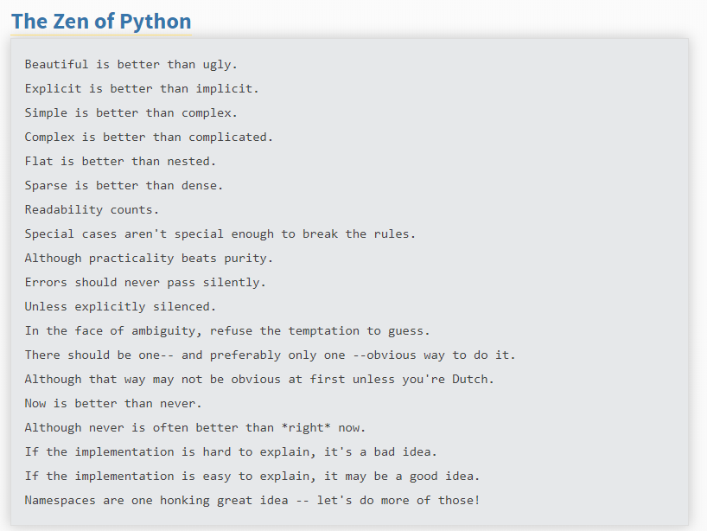
Guido van Rossum, 1991
Open source general purpose programming language with libraries
Widely regarded as easy to learn
Also used for web development, database access, desktop graphic user interfaces, automating network infrastructure, and software/game development
Use the Anaconda distribution for data analysis and Jupyter Notebook for documentation
Peters, 2004

Slide 5
Before you start a project
You’re teaching a computer
Use a workflow to start or draft a new one
Biopython or Bioconductor
Pseudocode

Slide 6
Vocabulary
Modules
Functions
a rule for what to do with an input
Ex: sqrt(x) gives the square root of x, sqrt() is the function
Variable
A value to store information you assign with = operator
Ex: seq_1 = “atagctgatttcctaggg” or len_seq= 18
Arguments
Input of a function
Ex: sqrt(x) gives the square root of x, x is the argument
Usually require a specific type of input ex: dataframe, vector, character variable
Python is case sensitive

Slide 7
Types of data
Numbers
Python as a calculator (recall order of operations or PEMDAS)
numerals
Strings
Python as a printer
Letters enclosed in quotes Ex: RNA sequences
Single, Double, and Triple quotes (for long strings)
print

Slide 8
Logical operators
=
If, Then, Else
For and while
In
Continue
True/False
Must be capitalized

Slide 9
Basic Built-in functions
Subsetting
Seq_1[0]
Seq_1[-1] =
Seq_1[:3] = start at col 0 until column 3
Length
len(seq_1)
Type
type(variable)
Help(function)
.count
.upper / .lower
.find /.rfind
.replace

Slide 10
Principal Components Analysis
Commonly used in RNASeq analysis to
Compressing the high-dimensional counts into their most important components (numerically)
Cluster data to show groups (we hope to see distinct groups)
Show how much variability is due to samples being in one group or another
PC 1 is the x-axis represents how much variability is contributed by the first term in your linear model
In DEG analysis this is usually case/control group
PC 2 is the y-axis and this represents variability contributed by the second term or by “unexplained” variability in your model
More on these in future RNASeq lectures, but they are a commonly generated graph and easy to implement in Python

Slide 11
In-class practice: pseudocode preparation for a PCA plot
Import numpy, sklearn, seaborn
Counts = matrix of counts
Sampledata = table of sample data
Scaledcounts = scale(counts)
pca = PCA(n_components = 2)
Combine PCs with target data

Slide 12
Next class: Python Basics (Practical)
Working with variables
Literate programming
Case sensitivity
Valid and invalid names
Plot PCs in 2D with seaborn (Next week)
Calculate explained variance (Next week)

Slide 13
Homework
Watch this 20 minute video on PCA in the context of RNASeq experiments

Slide 14
If curious
EICC GitHub
16s microbiome pipeline
RNASeq (bulk) analysis pipeline

Slide 15
Resources & References
Python for Beginners from Python
Reading List of Introductory Books from various authors from Python
Python Cookbook from O’Reilly
Python for Genomic Data Science from Johns Hopkins University
Python Cookbook from O’Reilly
Peters, T. (2004). PEP 20 -- The Zen of Python | Python.org. Retrieved April 14, 2019, from https://www.python.org/dev/peps/pep-0020/
https://plot.ly/python/v3/ipython-notebooks/principal-component-analysis/
https://www.rna-seqblog.com/statquest-pca-clearly-explained/
https://www.kindsonthegenius.com/2019/01/12/principal-components-analysispca-in-python-step-by-step/
https://scikit-learn.org/stable/modules/generated/sklearn.decomposition.PCA.html

